Slide 1

Advanced Algebra
Final Project
Lior Yaacov
February 2021

Slide 2
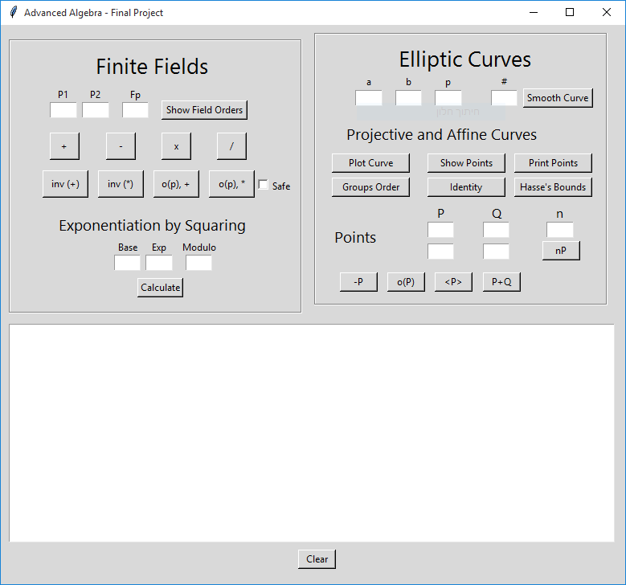
Summary
This is Advanced Algebra course Final Project
This program provides:
Finite Fileds
Modular Arithmetic
Elements inverse and orders
Safe-Prime multiplication order
Exponentiation by Squaring
Elliptic Curves
Curve and points plots
Groups orders
Hasse’s Bound Theorem
Points addition, inverse, order and generation
Point scalar multiplication
And more
Lecturers: Dr. Rony Bitan & Mr. Tomer Bauer
Bar-Ilan University
Github:
https://github.com/LiorYaacov/Advanced-Algebra.git

Slide 3
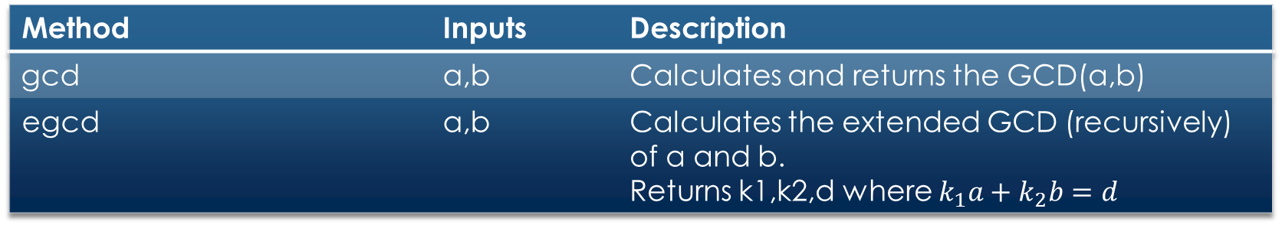
Class f_{p} – Classmethods
Description | Inputs | Method
Calculates and returns the GCD(a,b) | a,b | gcd
Calculates the extended GCD (recursively) of a and b. Returns k1,k2,d where $k_{1}a+k_{2}b=d$ | a,b | egcd

Slide 4
Class f_{p}
Description | Inputs | Method
Constructor method to initiate an Fp object. p is an element in the Fmod group | p,mod | __init__
Implement a+b (mod m) | self, p2 | __add__
Implement a-b (mod m) | self, p2 | __sub__
Implement a*b (mod m) | self, p2 | __mul__
Implement a mod b | self, p2 | __mod__
Implement a/b (mod m) | self, p2 | __truediv__
Implement a^b (mod m) | self, p2 | __pow__
Returns the multiplicative inverse | self | Inverse
Returns the additive and multiplicative groups orders | self | group_orders
 | self | add_element_order
 | self | mul_element_order
Calculates baseexp (mod m) using Exponentiations by Squaring algorithm | base,exp,m | exp_by_square

Slide 5
Class EllipticCurves
Description | Inputs | Method
Constructor method to initiate an EllipticCurves object | a,b,p | __init__
Returns all the points of the Affine curve group defined by a and b modulo p | self | affine_elliptic_curve_points
Returns the lower and upper bounds of the Hasse’s theorem | self | Hasses_bound
Plots all the points of the Affine group on a 2-dimensional graph | self | show_points
Plots the curve defined by a and b | self | plot_curve

Slide 6
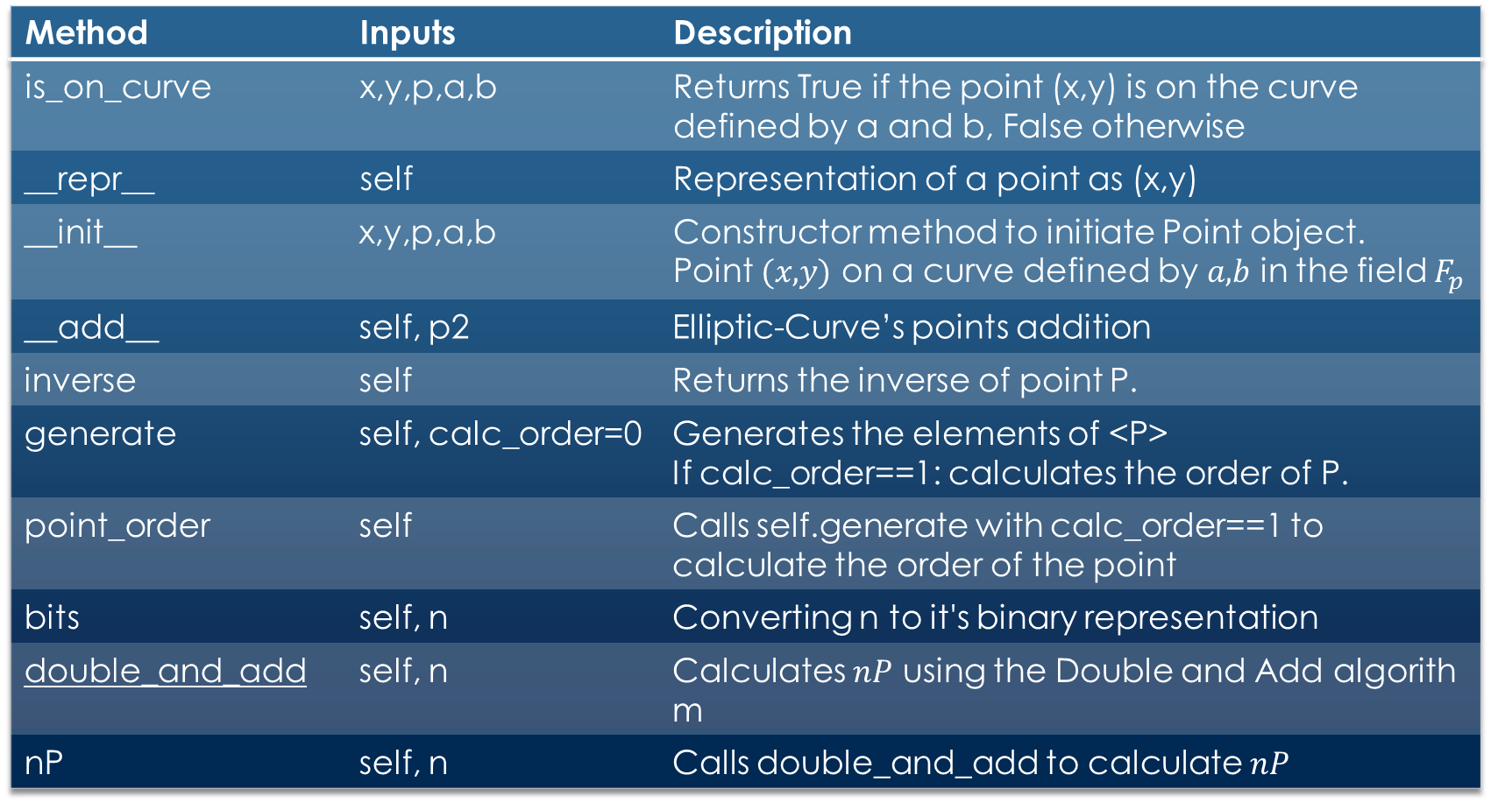
Class Point
Description | Inputs | Method
Returns True if the point (x,y) is on the curve defined by a and b, False otherwise | x,y,p,a,b | is_on_curve
Representation of a point as (x,y) | self | __repr__
Constructor method to initiate Point object. Point $(x,y)$ on a curve defined by $a,b$ in the field $F_{p}$ | x,y,p,a,b | __init__
Elliptic-Curve’s points addition | self, p2 | __add__
Returns the inverse of point P. | self | inverse
Generates the elements of <P> If calc_order==1: calculates the order of P. | self, calc_order=0 | generate
Calls self.generate with calc_order==1 to calculate the order of the point | self | point_order
Converting n to it's binary representation | self, n | bits
Calculates $nP$ using the Double and Add algorithm | self, n | double_and_add
Calls double_and_add to calculate $nP$ | self, n | nP

Slide 7
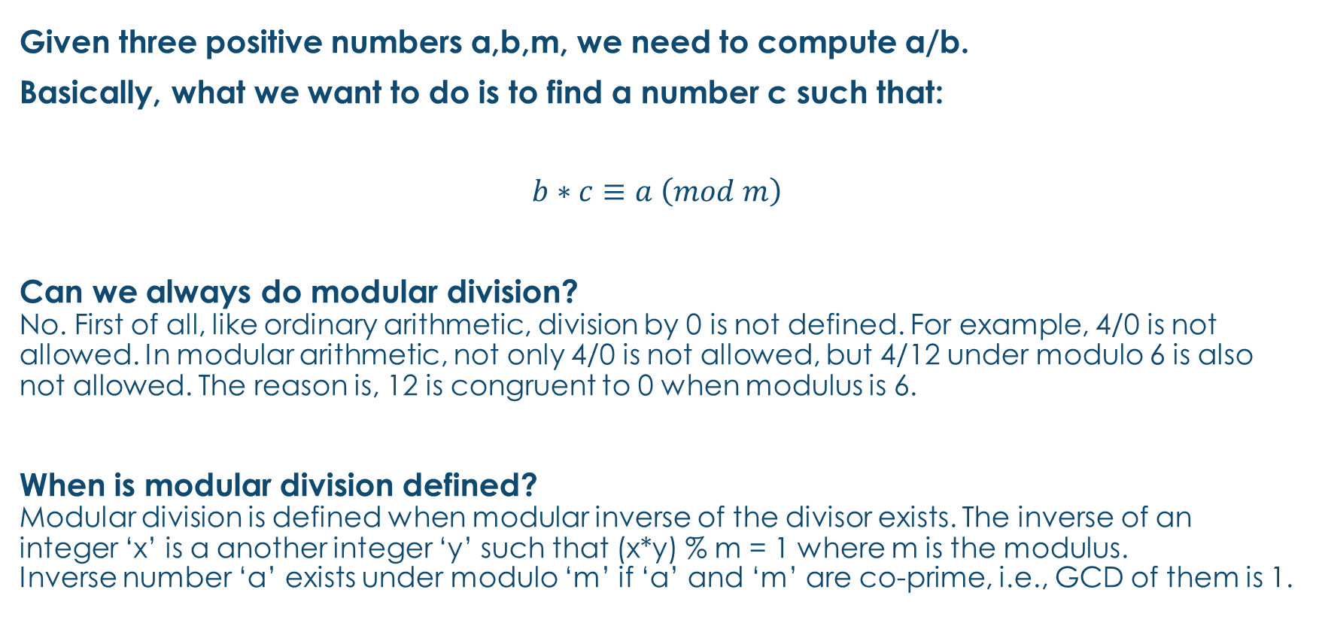
Modular Division
Given three positive numbers a,b,m, we need to compute a/b.
Basically, what we want to do is to find a number c such that:
$$b∗c≡a \left(mod m\right)$$
Can we always do modular division? No. First of all, like ordinary arithmetic, division by 0 is not defined. For example, 4/0 is not allowed. In modular arithmetic, not only 4/0 is not allowed, but 4/12 under modulo 6 is also not allowed. The reason is, 12 is congruent to 0 when modulus is 6.
When is modular division defined? Modular division is defined when modular inverse of the divisor exists. The inverse of an integer ‘x’ is a another integer ‘y’ such that (x*y) % m = 1 where m is the modulus. Inverse number ‘a’ exists under modulo ‘m’ if ‘a’ and ‘m’ are co-prime, i.e., GCD of them is 1.

Slide 8
Modular Division
Algorithm:
The task is to compute a/b under modulo m.
1) First check if inverse of b under modulo m exists or not.
a) If inverse doesn't exists (GCD of b and m is not 1),
print "Division not defined"
b) Else return "(inverse * a) % m"

Slide 9

Modular Inverse
We are looking for x such as:
Additive:
$$a+x≡0 \left(mod m\right)$$
Multiplicative:
$$a ∗x≡1 (mod m)$$
References:
https://www.omnicalculator.com/math/inverse-modulo

Slide 10

Exponentiation by Squaring
Exponentiating by Squaring is a general method for fast computation of large positive integer powers of a number
$$x^{n}=\left\{\begin{aligned}x{\left(x^{2}\right)}^{\frac{n−1}{2}} , if n is odd \\ {\left(x^{2}\right)}^{\frac{n}{2}} , if n is even\end{aligned}\right.$$
References:
https://en.wikipedia.org/wiki/Exponentiation_by_squaring

Slide 11

Hasse’s Theorem
$$Let E be a non−singular elliptic curve over a prime field 𝔽_{p}.$$
$$Let N_{p}\left(E\right) be the number of points on E.$$
Then:
$$N_{p}\left(E\right) ≈p+1$$
and
$$\left|N_{p}\left(E\right)−(p+1)\right| ≤2\sqrt{p}$$

Slide 12

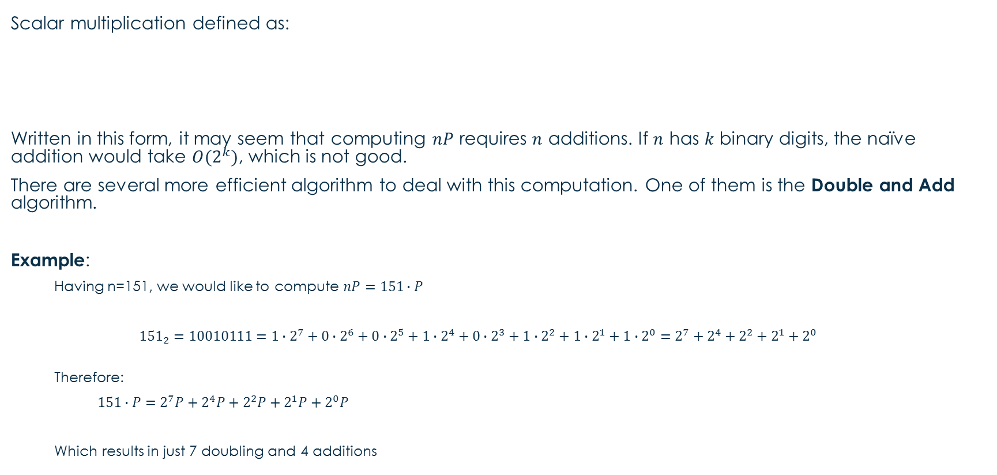
Double and Add Algorithm
Scalar multiplication defined as:
Written in this form, it may seem that computing $nP$ requires $n$ additions. If $n$ has $k$ binary digits, the naïve addition would take $O(2^{k})$, which is not good.
There are several more efficient algorithm to deal with this computation. One of them is the Double and Add algorithm.
Example:
Having n=151, we would like to compute $nP=151∙P$
$${151}_{2}=10010111=1∙2^{7}+0∙2^{6}+0∙2^{5}+1∙2^{4}+0∙2^{3}+1∙2^{2}+1∙2^{1}+1∙2^{0}=2^{7}+2^{4}+2^{2}+2^{1}+2^{0}$$
Therefore:
$151∙P=2^{7}P+2^{4}P+2^{2}P+2^{1}P+2^{0}P$
Which results in just 7 doubling and 4 additions

Slide 13
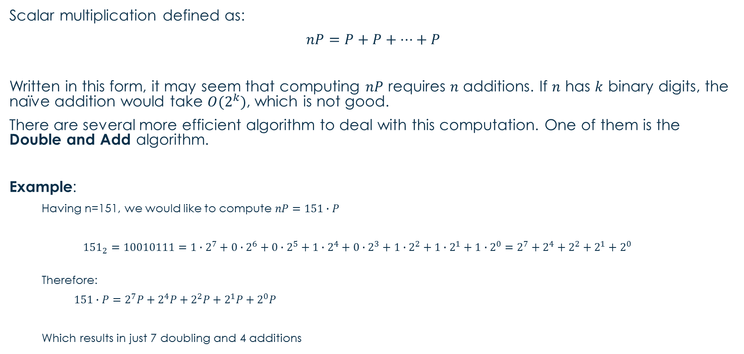
Double and Add Algorithm
Scalar multiplication defined as:
$$nP=P+P+…+P$$
Written in this form, it may seem that computing $nP$ requires $n$ additions. If $n$ has $k$ binary digits, the naïve addition would take $O(2^{k})$, which is not good.
There are several more efficient algorithm to deal with this computation. One of them is the Double and Add algorithm.
Example:
Having n=151, we would like to compute $nP=151∙P$
$${151}_{2}=10010111=1∙2^{7}+0∙2^{6}+0∙2^{5}+1∙2^{4}+0∙2^{3}+1∙2^{2}+1∙2^{1}+1∙2^{0}=2^{7}+2^{4}+2^{2}+2^{1}+2^{0}$$
Therefore:
$151∙P=2^{7}P+2^{4}P+2^{2}P+2^{1}P+2^{0}P$
Which results in just 7 doubling and 4 additions
n times

